Slide 1
FAC 9 WebRTC Workshop
Peter Wilson, IpCortex

Slide 2
Making the web ‘real-time’
Audio calls, Video calls, Phone calls (via gateway)
Using ‘standard’ technologies
Vanilla browser
No proprietary plugins (Flash)
No proprietary protocols (Skype)
The standardised framework is WebRTC
Web Real Time Communication
Most browser are adopting this now

Slide 3
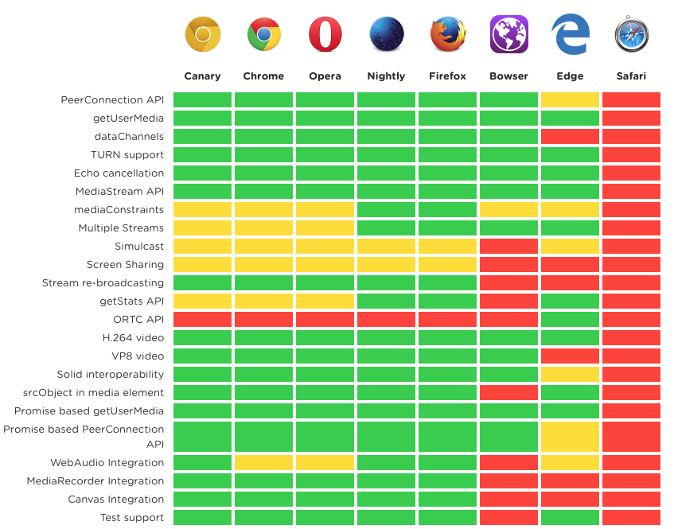
Is it all hype?

Slide 4
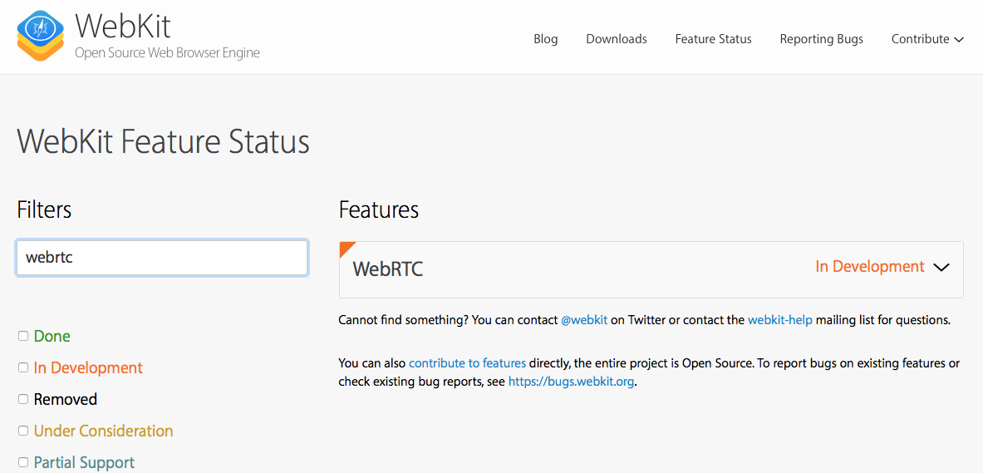
Apple Safari

Slide 5
Media Streams
Channels
MediaStream: Collection of Audio/Video Tracks MediaStreamTrack: One ‘device’ (eg camera, mic) Channel: Smallest Unit (left audio/ right audio)
Media Stream Track
Media Stream
https://developer.mozilla.org/en-US/docs/Web/API/Media_Streams_API

Slide 6
Media Stream
Unidirectional
Has one input and out output
Local inputs:
Microphone
Camera
RTCPeerConnection
Outputs:
<video> tag
RTCPeerConnection

Slide 7
Locally connecting media
Media Stream
<html>
<head>…</head>
<body>
…
<video></video>
</body>
</html>

Slide 8
Connecting between devices
Jim
Jane
RTCPeerConnection
webRTC
Media Stream
How do Jim and Jane find each other?
How is their traffic routed across the Internet through corporate firewalls?
How is permission asked to accept the call at the receiving end?

Slide 9
Signaling
“Signaling”
Jim
Jane
webRTC
Media Stream

Slide 10
Signaling
Allows two ends of an RTCPeerConnections to find each other
NOT standardised
Not necessary and much of this is application specific
Examples
IpCortex PABX – signaling, directory, presence and PTSN gateway (phone calls)
webRTC.io – one of the first libraries
Must be accessible to both parties
Provide a means of relaying information between the two parties
Should encrypt all communications
Usually a separate server

Slide 11
What is signaling used for?
Very simple WebRTC requirements
Transfer Javascript Objects between endpionts (eg serialised as JSON)
Send media ‘offers’ and ‘responses’ between end points
Swap communication ‘candidates’ between end points
Other signaling usually required for an application
End point discovery/name mapping (I’m Fred, I want to talk to Jane)
Presence (I’m Fred and I’m ‘online’)

Slide 12
Typical signaling exchange
Endpoint 1
Endpoint 2
Offer
SDP description
SDP description
Response
Candidate 1
Candidate 2
Candidate 1
Offers are send as Session Description Protocol messages
Candidates give options for how to connect end points across a network
Accomplished via the Interactive Connectivity Establishment (ICE) framework
Multiple ‘candidates’ are tested concurrently with the first (fastest) used

Slide 13
Signaling Overhead
Intentionally very low overhead
Typically 24 exchanges per WebRTC session
~10K data exchanged
Many techniques available
REST Polling
HTTP ‘Long Poll’
REST to the signaling server/ EventSource distribution to clients
WebSocket bi-directional ‘pipes’
Only requires text transfer
Not just for setup though – media can change during a call

Slide 14
Workshop – what we’re going to do…
Configure simple HTTPS server to serve scripts
Using streams locally Create a <video> tag in a static page Request media (camera and microphone) Attach media to video tag
Local Peer Connection and Signaling
Using streams between devices over a network
Building a simple remote ‘Presentation’ application using webRTC

Slide 15
2. Local stream
Request local media stream (video/audio)
Attach to browser <video> tag
<html>
<head>…</head>
<body>
…
<video></video>
</body>
</html>

Slide 16
2. Local media streams
var promise = navigator.mediaDevices.getUserMedia({ video: true, audio: true });
promise.then((avSteam) => { // Find my video tag… video = document.createElement('video');
attachMediaStream(video, stream); video.play(); // Add video tag to DOM videoContainer.append(v); }).catch(() => {…});

Slide 17
3. Local Peer Connection
<html>
<head>…</head>
<body>
…
<h2>Person 1</h2>
<video id=”person_1”></video> <button id=”Start Call”>Call</button>
<h2>Person 2</h2>
<video id=”person_2”></video> </body>
</html>
Connecting camera/mic to a local video tag THROUGH a peer connector
Implement our own local signaling
Shows the basic structure of how to connect streams to each other remotely without network complexity

Slide 18
3. Local signaling
Create a ‘signaling’ abstraction:
Announce(me), send(to), listen
Completely local
Single web page!
Announce(me)
Listen(msg)
Send(to)

Slide 19
4. Remote Peer Connections
Replace local signaling with node server proxy.
Options for transferring signalling:
AJAX Poller
Web Socket
NODE SERVER
Jim
Jane
webRTC
Media Stream

Slide 20
4. Signaling across a network
Split your signaling into two parts:
Carry information across the local network
Modify the application to have one end point per browser
Announce(me)
Listen(msg)
Send(to)

Slide 21
5. Remote Presentations
Presentation Server
1. Announce Presentation
2. Join Presentation
4. Send A/V Real time Stream
3. Negotiate session
Signaling Server
3. Negotiate session
Signaling: EITHER using IpCortex api OR modified signaling from previous task

Slide 22
Signaling for Remote Presentations: Two Options
Evolution of simple signaling from previous example
Should work on a local LAN
Won’t work across the Internet without TURN/STUN servers (complexity)
IPCortex API
Covers all the routing across the Internet
More complex to configure/run

Slide 23
References
MDN WebRTC
https://developer.mozilla.org/en-US/docs/Web/API/WebRTC_API
WebRTC.org – Getting Started
https://webrtc.org/start/
HTML 5 Rocks – Getting started with WebRTC (2012)
Good overview
Illustrates local signaling but not is a portable way
https://www.html5rocks.com/en/tutorials/webrtc/basics/
HTML 5 Rocks – WebRTC Infrastructure
Great overview of signalling – everything you need to know!
https://www.html5rocks.com/en/tutorials/webrtc/infrastructure/
adapter.js
Shim to isolate applications from browser incompatibilities
https://github.com/webrtc/adapter

Slide 24
adapter.js https://github.com/webrtc/adapter

Slide 25
RTCPeerConnection
var pc new RTCPeerConnection(); pc.onicecandidate = (e) => { this.send(from, "CANDIDATE", e.candidate); }; pc.onaddstream = (e) => { attachMediaStream(videoTag,e.stream); videoTag.play(); }
localMediaPromise.then((mediaStream) => { pc.addStream(mediaStream); console.log('PeerConnector (TX) createOffer start'); var offerOptions = {offerToReceiveAudio: 1, offerToReceiveVideo: 1}; pc.createOffer(offerOptions) .then((offer) => { console.log("WE HAVE AN OFFER...",offer); // Give the offer description to our end of the connector pc.setLocalDescription(offer); // Send the offer to the remote end of the peer connector this.send(from, "SDP_OFFER", offer ); }); // Attach this stream to a video tag... attachMediaStream(videoTag, mediaStream); // And set the 'play' state for this tag. videoTag.play(); });

Slide 26
RTCPeerConnection – incoming signaling
function receivedIncomingSDPoffer(from, data) { this.data.pc.setRemoteDescription(data); // And generate an answering offer this.data.pc.createAnswer().then( (desc) => { this.data.pc.setLocalDescription(desc); // And send this to desciption to the remote end this.send(from, "SDP_ANSWER", desc); }); } } function receivedIncomingSDPanswer(from, data) { this.data.pc.setRemoteDescription(data); } function receivedCandidate(from, data) { var candidate = new RTCIceCandidate(data); this.data.pc.addIceCandidate(candidate); }

Slide 27
Signaling object
Suggested methods…
var sig = registerEndPoint(myName, myListenerCallback);
sig.send(nameOfRecipient, operation, [data])
myListenerCallback prototype:
(nameOfSender, operation, data)
Make ‘this’ reference you ‘sig’ structure

Slide 28
myListenerCallback
function myListenerCallback(nameOfSender, operation, data) { switch (operation) { case ’INITIALISE’:
break;
case ‘INCOMING_CALL’: if (doIwantThisCall()) { this.send(nameOfSender, ‘ACCEPT’); else this.send(nameOfSender, ‘REJECT’); break; case 'SDP_OFFER': receivedIncomingSDPoffer.call(this, nameOfSender, data); break;
}
}

Slide 29
Tasks
1. Client
Modify client to have one end station
Change listener to exchange messages with server
2. Server
Very simple node server to implement signaling API
API Spec – as follows…

Slide 30
Workshop webRTC Signaling Spec
Two REST methods:
send
poll
Maintains a ‘directory’ of end points (similar to the client model)
var directory = { endpointName: { messages: [ {from:’endpointName’, method: ‘name’, data:’String’} ] } }
End point added to directory on first poll
‘data’ is an opaque package of data that is not unwrapped by the signalling.

Slide 31
Poll: https://server/poll/myname
myname – only parameter and is the name of the sending endpoint
Server Behaviour
If ‘myname’ is not in the directory then create it var directoryEntry = getDirectoryEntry(myname);
Reply with JSON formatted structure:
{ directory: Object.keys(directory), messages: directory[endpointName].messages }
Once this message has been sent: directory[endpointName].messages.length = 0; (Delete messages)

Slide 32
Send: https://server/send/myname/toname/method
HTTP POST request
Send a message from fromname to toname to invoke method
The message is in the post data body and is JSON formatted text
Server does not need to JSON.parse this text
Behaviour: if (directory[toname]!=null) { var directoryEntry = directory[toname]; directoryEntry.messages.push({ from: request.myname, method: request.method data:request.payload }); send reply – ‘success’ } else sendReply - ’unknown destination’

